Slide 1

Dr.Mahalingam College of Engineering & Technology
Department of Artificial Intelligence & Data Science
SUBJECT CODE : 19ADPN6801 Project
Third Review
Team Number : A20
Domain : Artificial Intelligence
Title : AI based Coding Support System for Differently Abled People
Faculty Supervisor: Ms. M. Rajalakshmi AP/AI & DS
Team Members : Sharanya T 727622BAD007
Santhosh S 727622BAD073
Aashif Shadin K N 727622BAD099
Track : Patent

Slide 2
Contents
Problem Description
Literature Survey Summary
Architecture Diagram
Result and Analysis
Claims
Abstract
Diagrams and figures
Algorithms used
Project demo
Conclusion

Slide 3
Problem Description
Traditional software development is physically demanding and often inaccessible, creating a significant gap in developer efficiency and inclusivity. The reliance on intensive keyboard and mouse usage leads to Repetitive Strain Injuries (RSI) and excludes individuals with motor impairments. Furthermore, the constant context switching between input devices disrupts coding flow, while existing voice-coding alternatives often compromise user privacy and introduce latency through cloud dependency. This project addresses these critical issues by providing a fully offline, voice-controlled development environment.

Slide 4
Limitations of existing systems
Cloud Dependency: Most modern tools require an internet connection to process voice commands, introducing latency in low-bandwidth environments.
High Cost: Many advanced voice assistants operate on a subscription model, making them inaccessible to students or developers in developing regions.
Steep Learning Curve: Some tools require memorizing complex phonetic alphabets or rigid command structures, reducing immediate usability.

Slide 5
Literature Survey Summary
S.No | Paper Title |  | Short Description (under 30 words)
1 | Voice-Controlled Programming for Assistive Technology | 2018 | Explores voice-based programming tools to support users with physical disabilities, highlighting benefits and limitations of speech-driven coding systems.
2 | Speech Recognition Techniques for Software Development | 2019 | Discusses speech-to-text methods applied to programming environments and challenges in handling syntax and code structure.
3 | Natural Language Processing in Intelligent IDEs | 2020 | Reviews NLP-based approaches for understanding developer intent and automating coding tasks within integrated development environments.
4 | Assistive Technologies for Accessible Software Engineering | 2021 | Analyzes existing assistive tools for programmers with disabilities and emphasizes the need for more context-aware solutions.
5 | AI-Based Voice Interfaces for Code Generation | 2022 | Presents AI-driven voice interfaces for generating and modifying code, focusing on usability, accuracy, and real-time interaction.

Slide 6
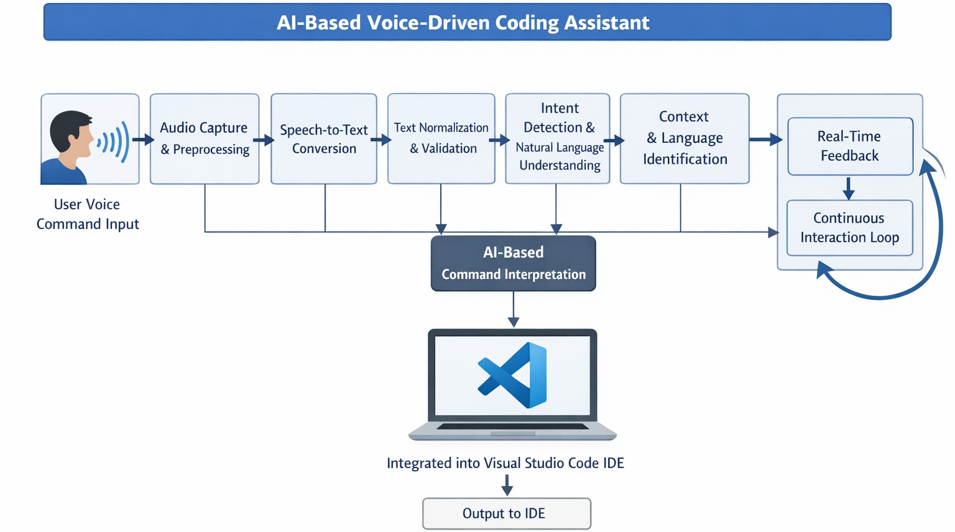
Architecture Diagram
Fig.1 Architecture diagram

Slide 7
Result and Analysis
Performance & Capabilities
Latency: Fast execution due to local speech processing (no network round-trip).
Accuracy: High accuracy for structured commands due to targeting specific keywords and regex patterns.
Supported Actions:
Navigation: Jump to specific lines ("Line 50"), Top/Bottom of file.
Editing: Delete lines, duplicate lines, comment/uncomment code.
Generation: Create boilerplate for loops (for, while), functions, and classes.
Control: Run code, undo/redo, stop listening.
Customized Code: Intelligent commands which uses AI LLMs to generate more than just template code snippets.

Slide 8
Claims
A voice-controlled programming assistant system, comprising a speech recognition engine, a natural language understanding backend, and an integrated development environment (IDE) extension, configured to convert spoken language into executable editing commands without external network dependency.
The system as claimed in Claim 1, wherein the speech recognition engine operates entirely offline using a lightweight model to ensure user privacy and zero data leakage.
The system as claimed in Claim 1, wherein the IDE extension captures real-time editor context, including cursor position and active language, to optimize command accuracy.

Slide 9
Claims
The system as claimed in Claim 1, wherein the backend logic is decoupled from the frontend extension to enable platform-agnostic deployment across different editing environments.
The system as claimed in Claim 1, further comprising a latency-optimized architecture that executes navigation and editing commands faster than traditional manual input methods.
The system as claimed in Claim 1, designed as an assistive technology to reduce physical strain and enable efficient hands-free coding for all developers.

Slide 10
Abstract
Modern programming environments are largely optimized for keyboard and mouse interaction, which creates accessibility challenges for developers with physical or motor disabilities. Although speech recognition and artificial intelligence have advanced significantly, their effective use in context-aware programming remains limited. This paper presents a voice-enabled, AI-based coding assistant that enables hands-free interaction within an integrated development environment. The system captures spoken commands, converts them into text using speech-to-text techniques, and interprets user intent using natural language processing. Based on the identified intent, programming actions such as code generation and modification are performed. Implemented as an extension for Visual Studio Code, the proposed solution enhances accessibility and supports inclusive software development practices.

Slide 11
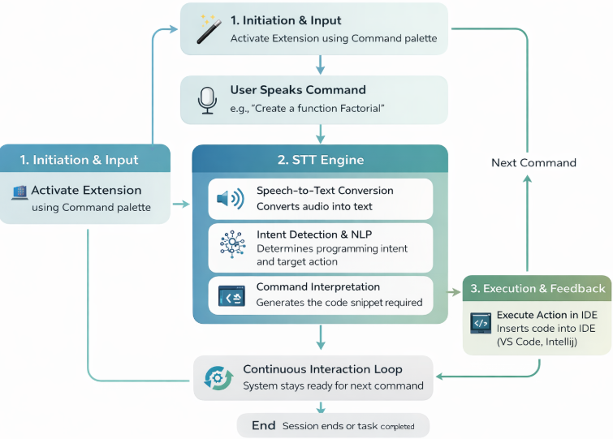
Diagrams and Figures
Fig. flow diagram

Slide 12
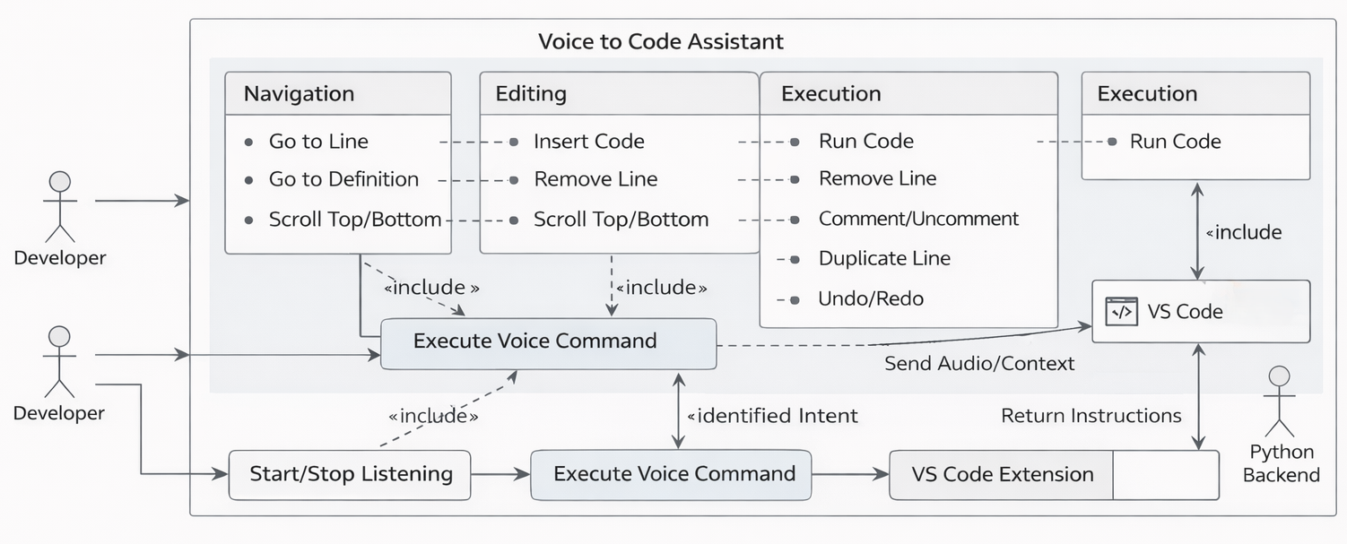
Diagrams and Figures
Fig. 3 Use Case Diagram

Slide 13
Algorithms & Technologies Used
Core Architecture: Decoupled Client-Server Model
Speech Recognition (Offline):
Engine: VOSK (Kaldi-based)
Why: Lightweight, offline-capable, and preserves privacy.
Intent Classification (NLP):
Logic: Regex-based pattern matching and keyword analysis.
Normalization: Text normalization to handle homophones (e.g., "nine twenty" -> "line 20").
Keyword Extraction: Identifies triggers like create function, remove line, goto.
Integration Layer:
Backend: FastAPI (Python) server processing intents and exposing a JSON API.
Frontend: TypeScript (VS Code Extension API) handling cursor movements, text edits, and editor commands.

Slide 14
Project Demo
Activation: "Start the Voice Assistant." (Show extension status bar changing to 'Listening').
Code Generation:
Say: "Create function calculate total" -> Generates def calculate_total():
Say: "Create class vehicle with start and run functions" -> Generates snippet with class and asked functions
Say: “Create for loop” -> Generates a for loop
Say: "Print hello world" -> Generates print("hello world")
Say: “code price equals 99” -> Generates variable ‘price’ with value 99
Navigation & Editing:
Say: "Line 10" -> Cursor jumps to line 10.
Say: "Duplicate" -> Duplicates the current line.
Say: "Remove line" -> Deletes the line.
Workflow:
Say: "Run code" -> Triggers the run command in terminal.
Say: "Stop listening" -> Deactivates the voice loop.

Slide 15
Project Demo
Activation: "Start the Voice Assistant." (Show extension status bar changing to 'Listening').
Code Generation:
Say: "Create function calculate total" -> Generates def calculate_total():
Say: “Create for loop” -> Generates a for loop
Say: "Print hello world" -> Generates print("hello world")
Navigation & Editing:
Say: "Line 10" -> Cursor jumps to line 10.
Say: "Duplicate" -> Duplicates the current line.
Say: "Remove line" -> Deletes the line.
Workflow:
Say: "Run code" -> Triggers the run command in terminal.
Say: "Stop listening" -> Deactivates the voice loop.

Slide 16
Conclusion
The Voice to Code Assistant successfully demonstrates that effective, hands-free programming is achievable without compromising privacy or relying on expensive cloud services.
By combining efficient offline speech recognition with deep IDE integration, we have created a tool that not only aids accessibility but also enhances developer productivity. This project lays the foundation for a future where coding is as natural as speaking.

Slide 17
References
Subhash S., P. N. Srivatsa, S. Siddesh, A. Ullas, and B. Santhosh, AI-Based Voice Assistant for Accessibility, 2020 Fourth World Conference on Smart Trends in Systems, Security and Sustainability (WorldS4), pp. 593–596, 2020.
Felix S. M., S. Kumar, and A. Veeramuthu, A Smart Personal AI Assistant for Visually Impaired People, 2018 2nd International Conference on Trends in Electronics and Informatics (ICOEI), pp. 112–117, 2018.
Chen R., Z. Tian, H. Liu, F. Zhao, and S. Zhang, Construction of a Voice-Driven Life Assistant System for Visually Impaired People, 2018 International Conference on Artificial Intelligence and Big Data (ICAIBD), pp. 87–92, 2018.
Rani P. J., J. Bakthakumar, B. P. Kumaar, U. P. Kumaar, and S. Kumar, Voice Controlled Home Automation Using Natural Language Processing (NLP) and IoT, 2017 Third International Conference on Science Technology Engineering & Management (ICONSTEM), pp. 45–50, 2017.
Iannizzotto G., L. L. Bello, A. Nucita, and G. M. Grasso, A Vision and Speech Enabled Customizable Virtual Assistant for Smart Environments, 2018 11th International Conference on Human System Interaction (HSI), pp. 50–56, 2018.

Slide 18
THANK YOU

